Slide 1

The Internet of Things
CHANGING HOW WE LIVE AND WORK
Service Management
IoT
Oleksandr Rotaienko

Slide 2

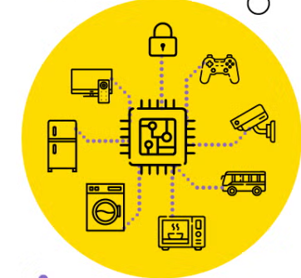
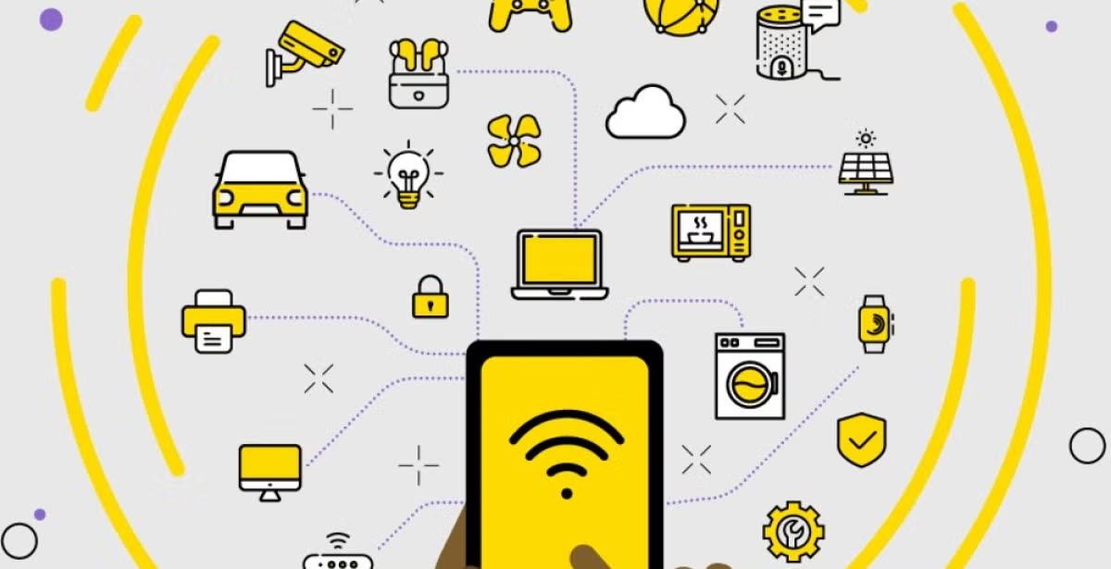
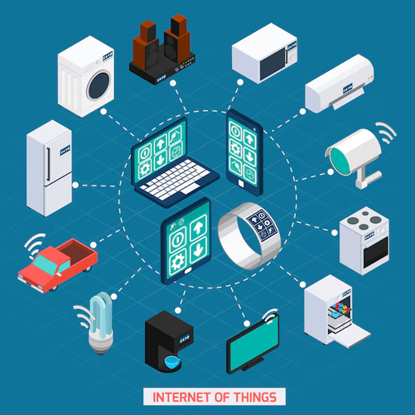
What Is IoT?
Connecting physical objects to the internet to collect and share data

Slide 3
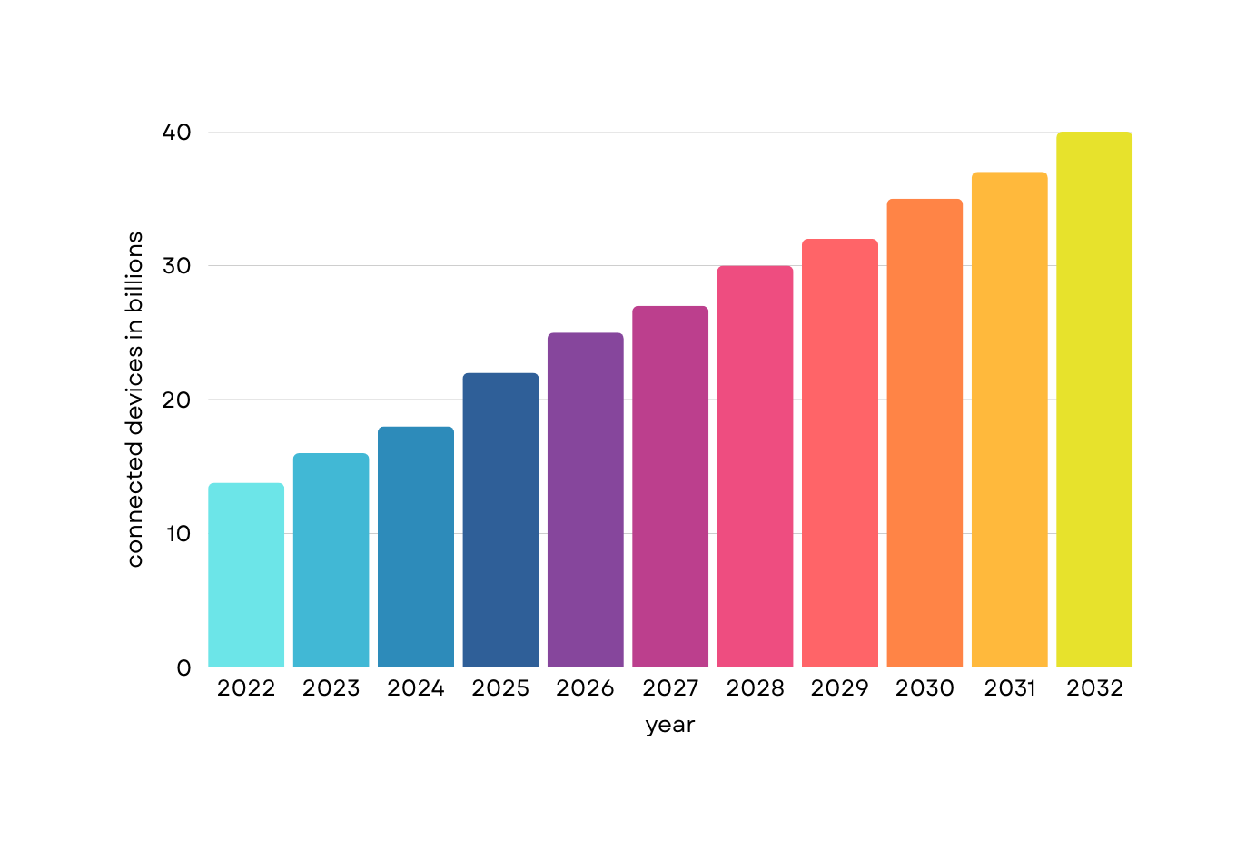

Why IoT Matters
25+ billion devices by 2030

Slide 4
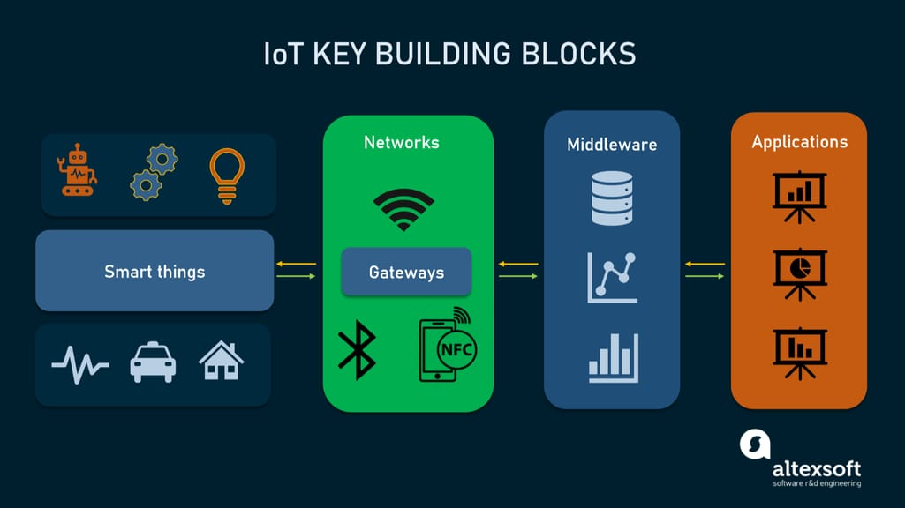
Core Architecture of IoT Systems

Slide 5



Real-World Use Cases in IT and Industry
Smart Infrastructure:
Healthcare IT
Smart Factories (IIoT)
Cyber-Physical Systems:
+

Slide 6
IoT Security Risks and Real Incidents
01
02
03
Problem 1
Problem 2
Problem 3
Default passwords and outdated firmware
Lack of encryption or authentication
The Mirai botnet (2016) hijacked hundreds of thousands of IoT devices to launch one of the largest DDoS attacks in history

Slide 7
IoT + Cloud + Edge = The Future
Edge Computing
Local data processing reduces latency (e.g., AWS Greengrass, Azure IoT Edge)
Cloud Integration
AIoT
Digital Twins
Scalable data storage, ML/AI training models, centralized dashboards
AI + IoT = autonomous decision-making systems (e.g., smart surveillance, maintenance prediction)
Virtual models of real-world systems that mirror and predict behavior using live IoT data

Slide 8
Developer Roles and Tech Stack
Embedded Developer
IoT Architect:
Embedded Developer
Embedded Developer
Cybersecurity Specialist
Design entire system flow from devices to cloud
Write firmware for sensors and microcontrollers
Set up MQTT brokers, manage data pipelines on AWS IoT Core
Use tools like Grafana to visualize sensor trends or predict anomalies
Secure APIs, encrypt payloads, and test for vulnerabilities

Slide 9





Ethical and Social Implications of IoT
Autonomy vs. Automation
Data Privacy
Surveillance
Bias and Discrimination
Digital Divide

Slide 10
Final Thoughts
01
02
03
IoT is reshaping how we build and use IT infrastructure
Deep knowledge in networking, security, data, and systems architecture is essential
Edge + Cloud + AI is where innovation is heading

Slide 11
Thank You
FOR YOUR TIME
Service Management
IoT
Oleksandr Rotaienko

